Slide 1
CITATIONS
CITED?
APA?
WEBSITE?
BOOK?
WHO?
MLA?
FORMAT?
WHERE?
CONSEQUENSES?
WHAT?
WHY?
COLLEGE?
SOURCE?
LONG-QUOTE?
IMAGE?
DATE?
WHAT ARE THEY?
SIZE?
DOCUMENT?
FONT?
ARE THEY EVEN IMPORTANT?
QUOTE?
HOW?
PDF?
SPACING?
AUTHOR?
VIDEO?
ORIGINALITY?
WHY DO WE NEED THEM?
WHEN?
HEADINGS?
IN-BODY?
VALIDATIONS?
PLAGIARISM?
EVERYTHING YOU NEED TO KNOW AND MORE…

Slide 2
Formats
APA
MLA
An academic style used in the United States for modern language
You will use this format for Global Perspectives!
Used for academic documents except English classes
V.S.

Slide 3
What makes a "Good Source"?
The source is authored and documented publication date
Author is well known and has the specific credentials to report on the subject
Contain relevant & accurate information to the paper
Who is the publisher and are they well known?
Is the source two-sided?
Is it global?
Objectivity of the source

Slide 4
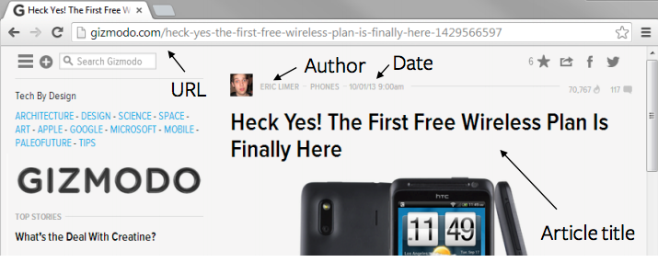
How to: Cite Documents & Websites
Example: Author, F.M. (Year, Month Date of publication). Title of webpage/article. Retrieved from URL
  Note: Only include the retrieval date if the content is likely to change over time (such as wikis). If necessary, include the retrieval month date, year, (in that order) between “Retrieved” and “from URL” in the last segment of the citation.
Example: Limer, E. (2013, October 1). Heck yes! The first free wireless plan is finally here. Retrieved from http://gizmodo.com/heck-yes-the-first-free-wireless-plan-is-finally-here-1429566597

Slide 5
How to:
Cite PDF (Portable Document Format)
The key to understanding how to cite a PDF is:
Always cite the PDF based on what the source in the file actually is.
A PDF, after all, is not really a source itself, but rather a file type and a way for displaying that source.
For example, if the source you wish to cite is a PDF of a newspaper article, cite the source as you would a newspaper.
Then, depending on the citation style you are using, you can add a short note to the citation that indicates that the source was in PDF format.
In an APA citaion, you can add “[PDF file]” after the title (separated by only space)
Example: United States Department of Housing and Urban Development. (2008). Indiana income limits [PDF file]. Retrieved from http://www.huduser.org/Datasets/IL/IL08/in_fy2008.pdf

Slide 6
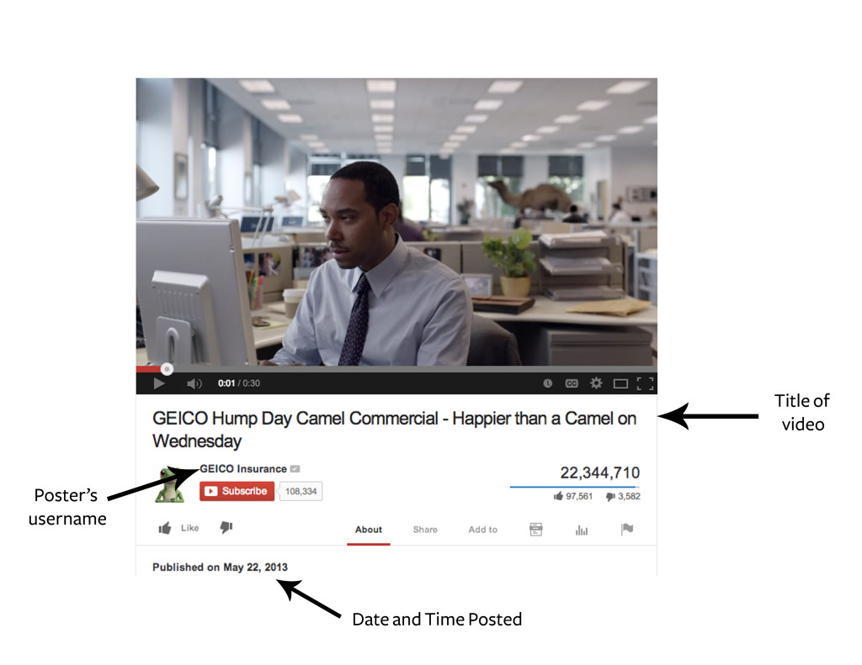
How to: Cite Videos
Format: Last Name, F.M. [Username]. (Year, Month Date). Title of video [Video File]. Retrieved from URL
Example: [GEICO Insurance]. (2013, May 22). GEICO hump day camel commercial – happier than a camel on Wednesday [Video File]. Retrieved from http://youtu.be/kWBhP0EQ1lA

Slide 7
How to: Cite Books
Physical Copy:
  Format: Last, First initial. Middle initial. (Year Published) Book. City, State: Publisher.
  Example: James, H. (1937). The ambassadors. New York, NY: Scribner
Online Copy:
  Format: Last, F. M. (Year Published) Book. Retrieved from URL
  Example: James, H. (2009). The ambassadors. Retrieved from http://books.google.com
Book From a Database:
  Format: Last, F. M. (Year Published). Book. Retrieved from URL
  Example: Morem, S. (2005). 101 tips for graduates. Retrieved from http://www.infobasepublishing.com

Slide 8
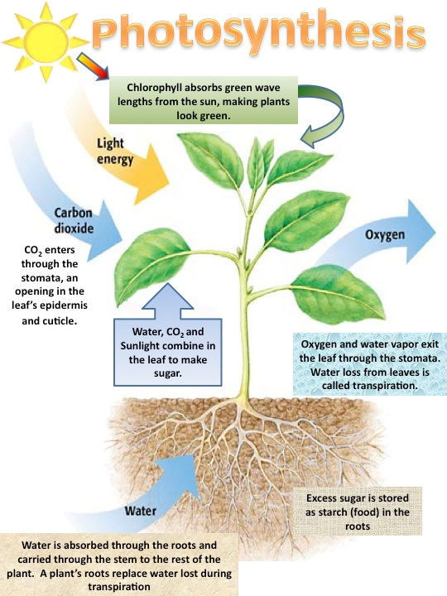
How to: Cite Images/Diagrams
Most images do not have a title and are often unauthored. Refer to those slide for more information. However, you can always click on the image which wil direct you to the page where the image is found and may contain an author, title, and date.
Format: [Description]. (date of publication). Retrived date.. , from website...
Ex: [Photosynthesis]. (2019). Retrieved April 29, 2019, from http://4.bp.blogspot.com/-QwuJxJTZgaE/UT7kPqFUCiI/AAAAAAAAAbM/HouRPyi0VLM/s1600/photosynthesis process.jpg

Slide 9
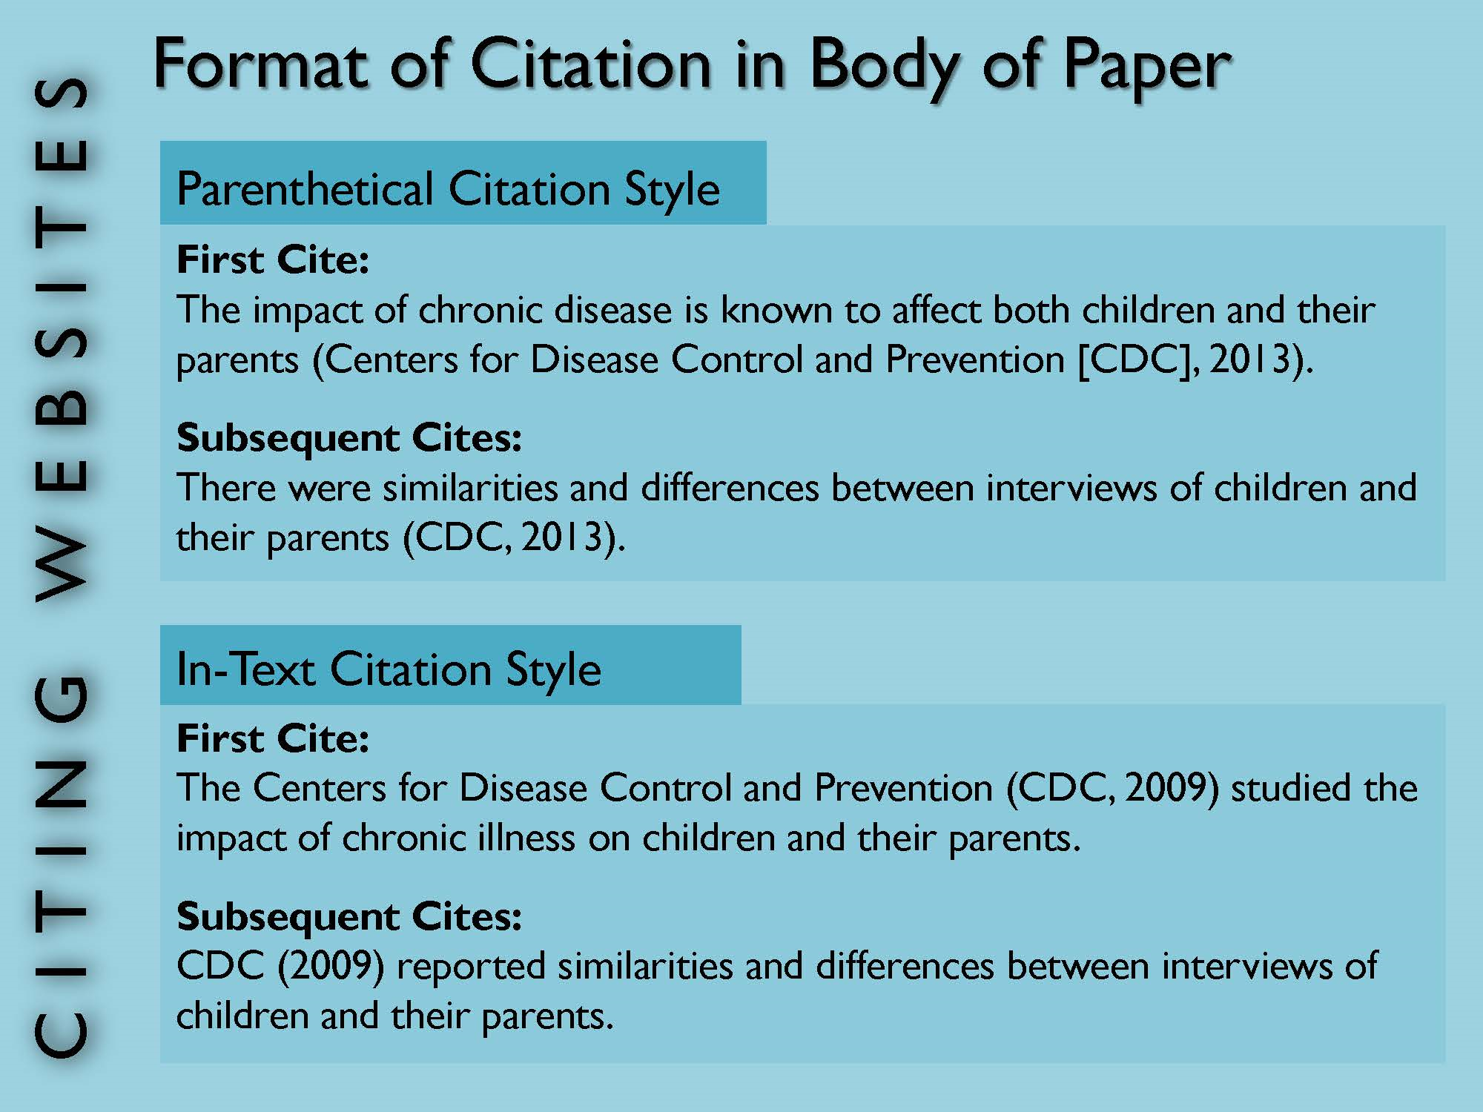
How to:
In Body Citation w/ organization using APA format
Notice that the period goes after the parenthetical citation.
Large organizations such as the Center for Disease Control can be abbreviated to CDC in the citation which can then be abbreviated in future citations to save your word count!

Slide 10
No author? No problem!
Don't write anonymous!
If the source being used is not authored, simple use the title of the article when curing but be aware that unauthored sources usually aren't the best sources unless the information is directly coming from a reputable organizations such as the United Nations, Government sources, and health organizations, etc.
Ex: (What are genome editing and CRISPR-Cas9?, 2019).

Slide 11
No Title? No problem!
If your source does not have a title, ask yourself if this is the best source to use. Many mediums that do not have titles are usually images and blogs and aren't the most reliable . However, if you decide to e this source regardless, you can make up a title based on the content in the source and place in brackets.
Author. (Publication Year) [title]. Retrieved from Insert website.

Slide 12
What if there is not a date of publication?
King A. (n.d.)Being mindful During a Dog Walk. Bark Bark Friends. Retrieved from http://www.barkbarkfriends.com/mindful_dog_walks/
Most sites do include a date of publication or a date when the post was last modified.
Don't overly rely on citation machine to automatically enter all the information for a citation. Many times it does not include the author or date of publication. It is always good to have the actual site being cited pulled up to review if any information is missing. Many times the author and date may be found at the end of the document however, if there is not a date of publication use the current year when citing.
For example, if you are citing a document from an organization and it does not explicitly state when it was posted use the current year when the information was founded.
In body citation: (Being Mindful During a Dog Walk, 2019)
Full Citation: King A. (2019) Being Mindful During a Dog Walk. Bark Bark Friends. Retrieved from http://www.barkbarkfriends.com/mindful_dog_walks/
Don't make this mistake! (nd.) means that there is no date which is unacceptable for Global Perspectives and future classes.

Slide 13
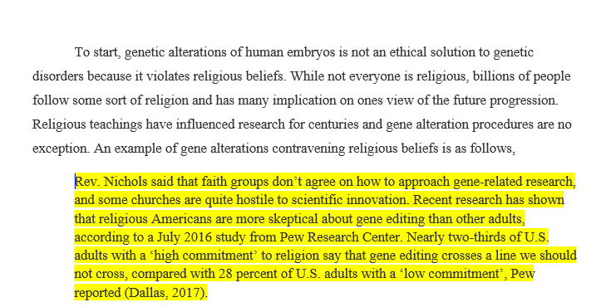
How to: Long Quote Format
If your quote is more than 2 lines ond you will use long quote format.
Simply highlight the quote with your mouse and press tab twice.
Remove quotations and use single quotation when using a direct quote from the author that they say otherwise you can paraphrase and use ellipsis to use the information that is most important.

Slide 14
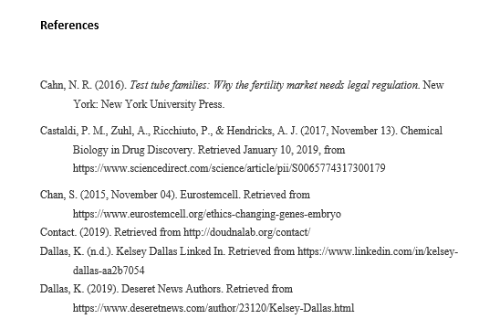
How to: Reference Page
Your reference page will be the last few pages of your paper and will not be included in your word count!
Left hand side, bolded
Alphabetical order
Double spaced
Hanging Indent

Slide 15
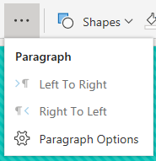
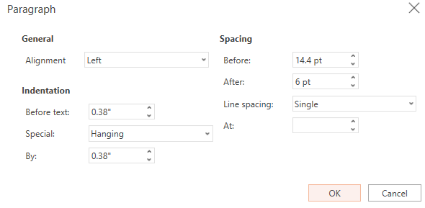
How to: Hanging Indent
On your references page, all APA citation must have a hanging indent if the citation is more than one line on the page.
(1) Highlight citations
(2) Under the home button press the button with ellipsis.
(3)Then press parenthetical options.
(4) Then this screen will appear. Press hanging and then ok and your citations will have hanging indents

